Slide 1
CAPSTONE PROJECT
Presented By:
1. Sarthak Raj
ITER- CSE

Slide 2
OUTLINE
Problem Statement (Should not include solution)
- Proposed System/Solution
- System Development Approach (Technology Used)
- Algorithm & Deployment
- Result (Output Image)
- Conclusion
- Future Scope
- References

Slide 3
PROBLEM STATEMENT
PROBLEM STATEMENT
Students often struggle to make informed career decisions due to fragmented guidance,
limited self-awareness of strengths, and a fast-changing job market. Traditional counseling
methods lack personalization and scalability, leading to mismatched career paths and
missed opportunities. There is a need for a system that autonomously tracks student data
and industry trends to provide accurate, real-time career guidance with minimal human intervention.

Slide 4
PROBLEM SOLUTION SQL
The proposed solution is an intelligent autonomous agent that provides dynamic career
counseling using the following features:
- Real-time monitoring of academic performance, interests, and behavior.
- Integration of job market trends using APIs.
- Personalized career path recommendations.
- Minimal manual dependency through automation and AI.
- Scalable cloud deployment using IBM Cloud Lite / Granite foundation models.

Slide 5
SYSTEM DEVLOPMENT APPROACH
Frontend: ReactJS / HTML + CSS (Dashboard)
- Backend: Flask or Node.js for API endpoints
- AI/NLP: IBM Granite foundation models for reasoning and decision making
- Storage: IBM Cloudant / IBM Object Storage
- Deployment: IBM Code Engine or Container Registry (free tier)
- Integration: Skill analysis via surveys, resume parsing, and academic data

Slide 6
ALGORITHM DEPLOYMENT
- Algorithm: Decision Tree / Rule-Based Engine + IBM Granite
- Input: Academic grades, skill ratings, interest forms, job trends from API
- Training: Pattern mining from previous student success + static logic rules
- Prediction: IBM model classifies ideal domains based on matching patterns
- Deployment: Backend on IBM Cloud Code Engine, accessed via REST APIs

Slide 7
RESULT
The system suggests top 3 career pathways based on input profile.
Sample Output:
- Student A: Data Scientist, Business Analyst, AI Researcher
- Student B: UX Designer, Product Manager, Tech Consultant

Slide 8
CONCLUSION
The system successfully automates career guidance using AI and IBM technologies.
It minimizes manual intervention and enhances accuracy by analyzing dynamic personal
and labor market data.
Challenges: Mapping domain-specific interests, integrating multiple APIs.
Improvements: More granular interest detection, multi-language support.

Slide 9
FUTURE SCOPE
- Add support for regional languages
- Integrate internship/job portals like LinkedIn, Internshala
- Mobile App version using React Native
- Include feedback loop for model improvement
- Add personality and psychometric testing

Slide 10
REFRENCES
- IBM Granite Foundation Models Documentation
- Career Guidance Research Papers
- Labor Market APIs (e.g. LinkedIn, RapidAPI)
- IBM Cloud Documentation

Slide 11
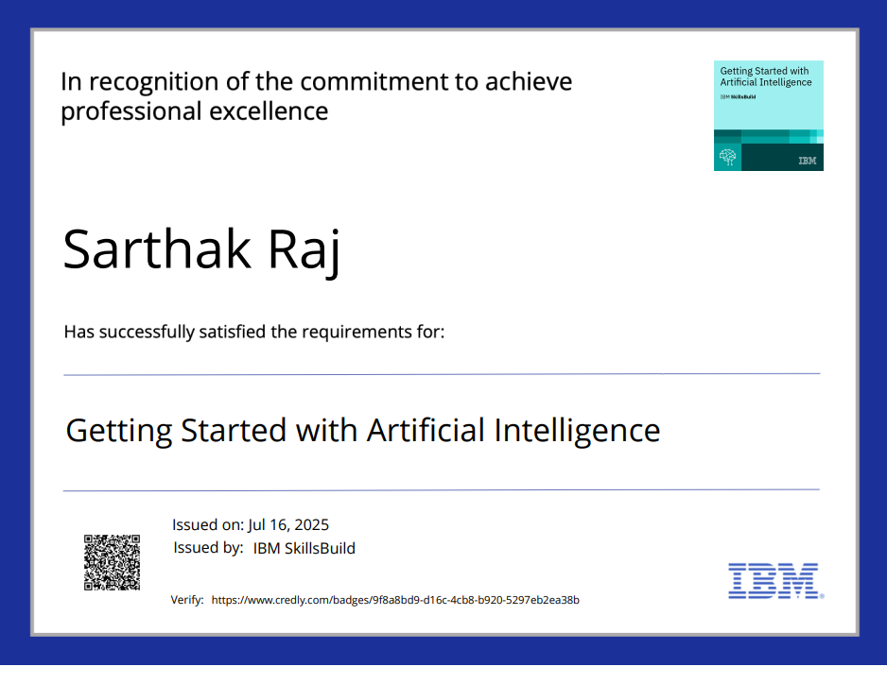
CERTIFICATE 1

Slide 12
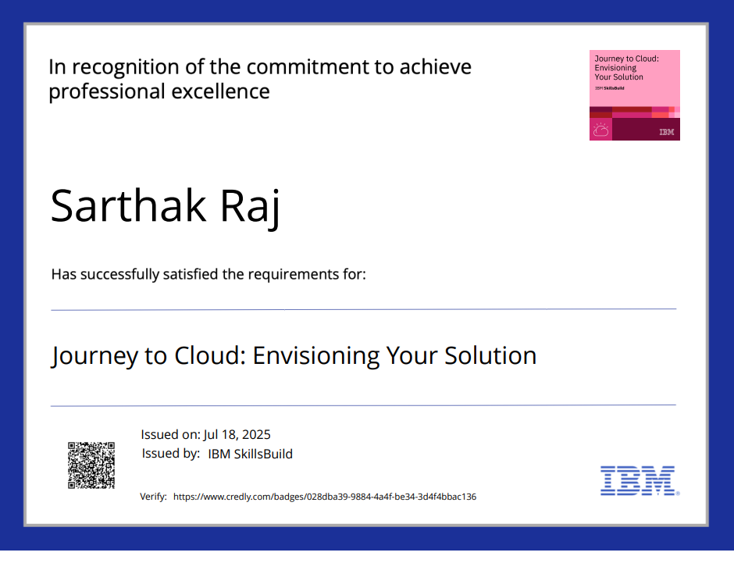
CERTIFICATE 2

Slide 13
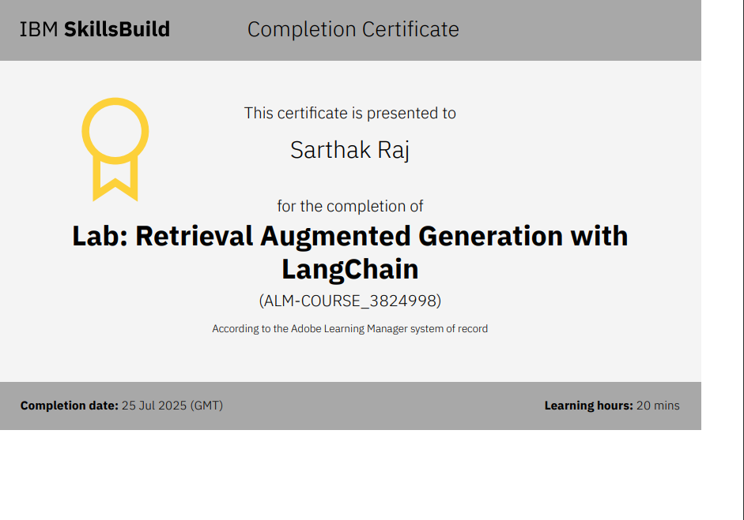
CERTIFICATE 3

Slide 14
THANK YOU
THANK YOU FOR YOUR TIME

